Slide 1


[AUDIT ON SOCIO BUZZ]

Slide 2


Today's agenda
Project recap
Problem
The Analytics team
Process
Insights
Summary

Slide 3

Social Buzz is a fast growing technology unicorn that need to adapt quickly to it’s global scale.
Accenture has begun a 3 month POC focusing on these tasks:
An audit on Social Buzz’s big data practice
Recommendations for a successful IPO
Analysis to find Social Buzz’s top 5 most popular categories of content
Project Recap

Slide 4

Over 100000 posts per day
36,500,000 pieces of content
per year!
But how to capitalize on it when there is so much?
Analysis to find Social Buzz's top 5 most popular categories of content
Problem

Slide 5



Andrew Fleming
Chief Technical Architect
The Analytics team
Marcus Rompton
Senior Principle
Deep Ranjan
Data Analyst

Slide 6
Process
1
Data Understanding
2
Data Cleaning
3
Data Modelling
4
Data Analysis
5
Uncover Insights

Slide 7

Insights
16
ANIMAL
MAY
UNIQUE
CATEGORIES
MOST REACTION
POST
MONTH WITH
MOST POST

Slide 8
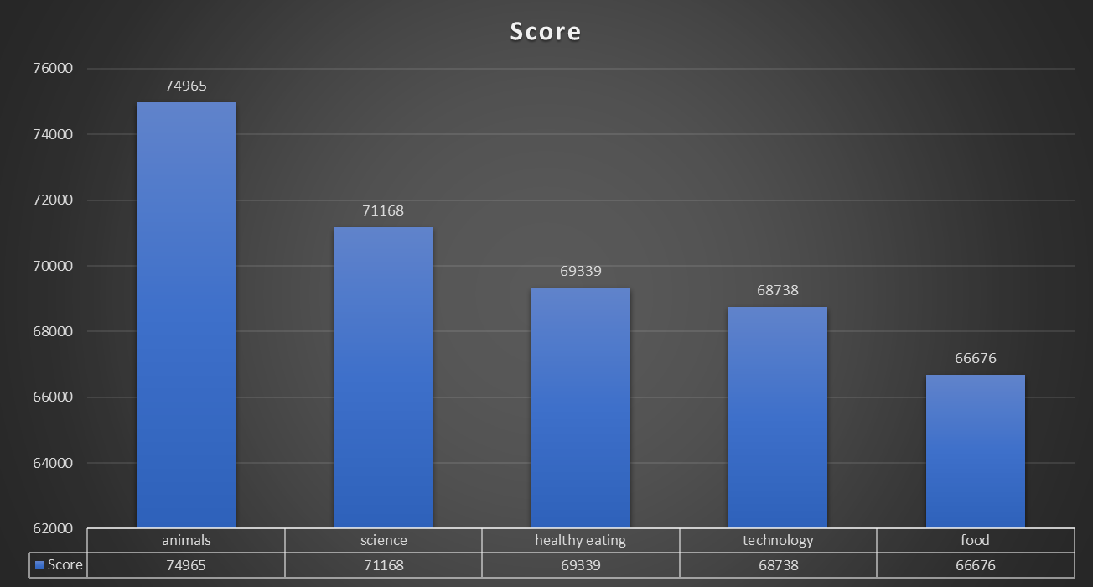

Slide 9
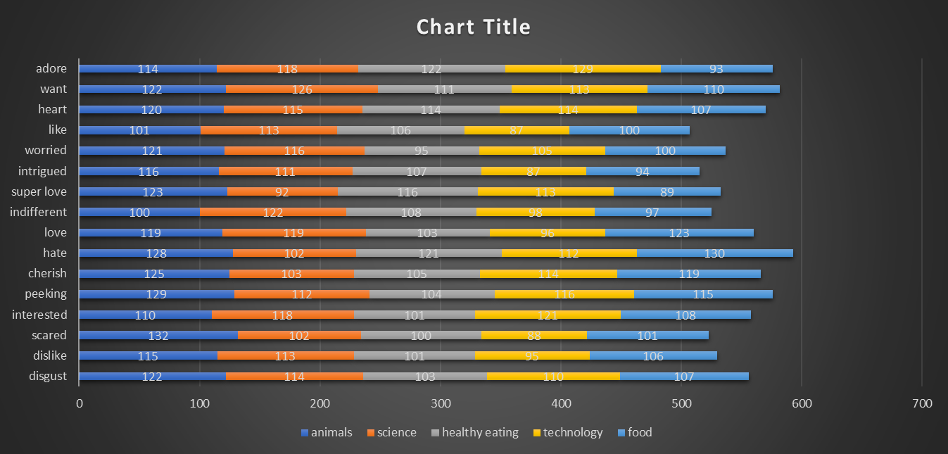

Slide 10

There are a total of 16 distinct content categories. Out of which Animal and Science categories are the most popular one.
4 types of content-Photo, Video, GIF and Audio, out of which people prefer photo and video the most
May month has the highest number of posts and stands at 2138 posts, while February month has the lowest number of posts (1914 Posts)
Summary
Conclusion
Social Buzz should focus more on the top 5 categories that's Animal, Technology, Science, Healthy eating and food and can create campaign to specifically target those audiences.
Social Buzz can need to maxim maximize in the month of January, May and August as they number of posts in these months are the highest.

Slide 11
Thank you!
ANY QUESTIONS?

